Slide 1
Attenborough and the Role of the Media
AMES Conference 2026

Slide 2
Thanks
Stephanie Benzies - provided the idea
Media Teachers Team - shared resources
Louise Sedgewick - gave me her stuff too!!!

Slide 3
Role of the Media
Texts also work for other key aspects!
Meeting Needs
Achieving Purposes
Influencing Behaviour and Attitudes
N5 - 10 marks (currently - might change in 2027)
H - 20 marks

Slide 4
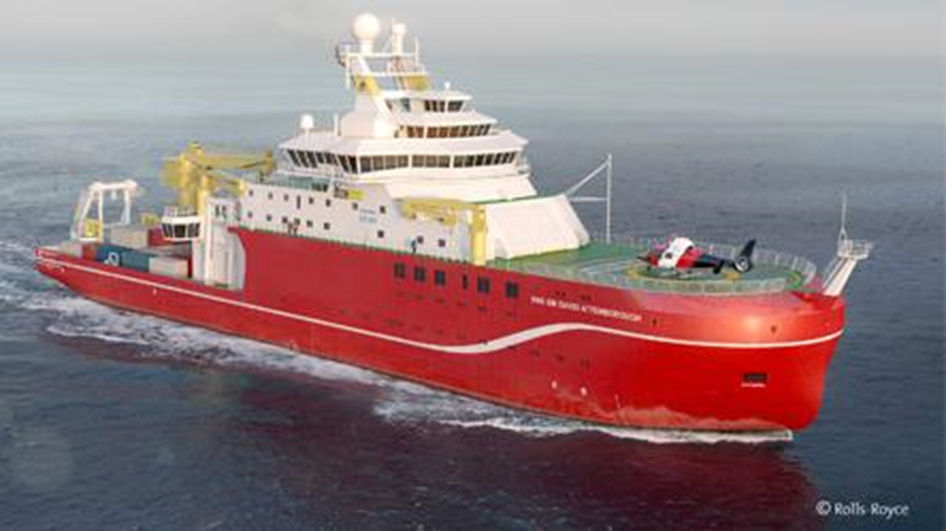
Notes:
Boaty McBoatface is a globally famous robotic yellow submarine (an Autosub Long Range autonomous underwater vehicle) operated by the UK's National Oceanography Centre. It originally became a viral internet sensation in 2016 when it won a public poll intended to name a new £200 million polar research ship. [1, 2, 3]
The Public Vote & The Ship
In 2016, the UK's Natural Environment Research Council held an online poll to name a brand-new scientific research vessel. "Boaty McBoatface" won by a landslide with over 124,000 votes. [1, 2, 3, 4, 5]
The Decision: Officials decided the humorous name wasn't fitting for a multi-million-pound flagship. Instead, they named the grand vessel the RRS Sir David Attenborough.
The Compromise: To honor the public's overwhelming choice, officials decided to bestow the name Boaty McBoatface onto one of the ship's high-tech, autonomous underwater submersibles

Slide 5
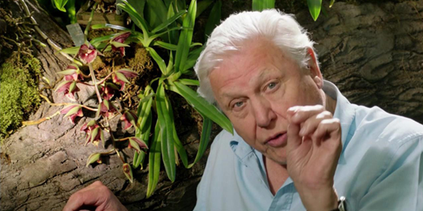
David Attenborough
National treasure.
Born 1926, massive celebration across BBC about being 100 - https://www.youtube.com/watch?v=-o-9h_hGpn8
Most famous as nature programme presenter - studied Zoology and Geology at University
Was initially producer then presenter of Zoo Quest as a stand-in. Controller of BBC Two from 1965 to 1969. Commissioned Civilization. Left BBC management in 1972 to focus on making programmes as writer and presenter.
Shift from informative to educational/persuasive programmes over time - focus on conservation and climate change impact.
Notes:
Role of the expert!

Slide 6
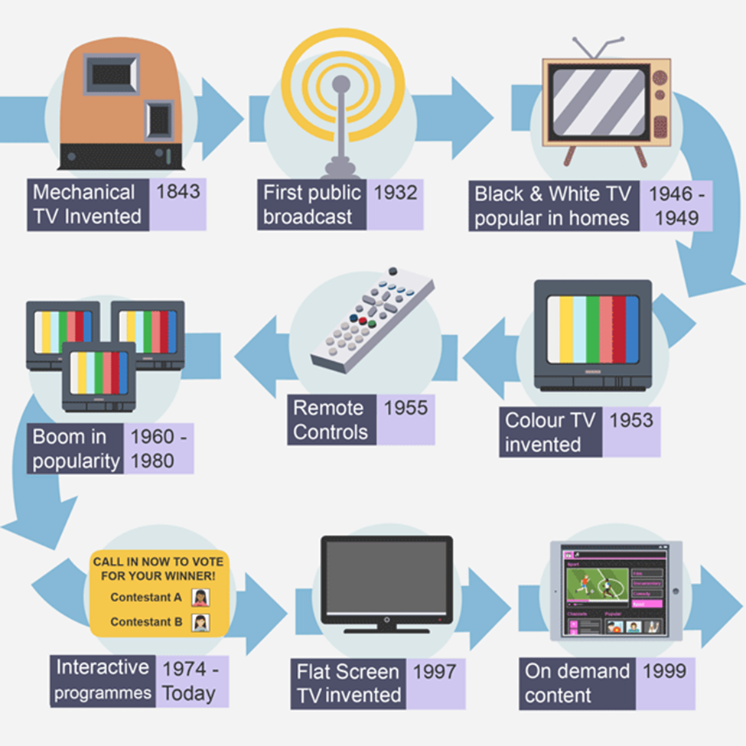

Slide 7
Attenborough and Technology
Black and white - colour
Time lapse
Super slow motion
Infrared cameras
Underwater
Drones

Slide 8
Potential Texts
Blue Planet (2001) - focuses on Marine life with strong anti-pollution message
Planet Earth (2006) - focuses on various habitats and their conservation
Frozen Planet (2011) - focuses on Arctic and Antarctic. So many penguins.
Life on Earth (1979) - fascinating contrast to more modern programmes, famous Gorilla sequence
Various paleontological focused documentaries e.g. Attenborough and the Sea Dragon
Secret Garden (2026) - Episode 5, “The Western Highlands” - good but twee

Slide 9
Blue Planet II (2017)
Original Blue Planet - 2001
Going to be called Oceans
Most watched TV programme of 2017 - top four slots of most watched programmes top 10
Won National Television Award Impact Award, BAFTA Must See Moment
Tie-ins - Soundtrack album, book, DVD, Podcast
Seven episodes - 7th overview of entire series and hardest push for public awareness

Slide 10
Audience
People interested in nature
Last huge audience share, potentially last family programme
Appeals from children to older adult, all genders
Theresa May “Public service broadcasting as its finest” (2017 in Parliament)

Slide 11
Audience - Broadcast
Shown in the UK on Sundays BBC One, 8-9pm
Also on i-Player
14.01 million for first episode

Slide 12
Audience - Readings
Preferred Protect wildlife Protect nature | Negotiated Reduce plastic waste where possible
Differential ???? | Oppositional Climate change deniers Businesses involved in waste

Slide 13
Blue Planet II Effect (or the Attenborough Effect?)
Seen as a turning point in awareness of plastic pollution - e.g. BBC going plastic free, Waitrose supporting reduction
Noticeable uptick in applications for Marine Biology courses
“airing of Blue Planet II was not only linked with a boost in public interest, but also allegedly with changes in plastic consumption behaviors (Collins, 2018), a phenomenon dubbed the “Blue Planet Effect”” But no observed change over time … (https://conbio.onlinelibrary.wiley.com/doi/10.1111/csp2.280)

Slide 14
Institution
BBC - “inform, educate and entertain”
BUT
Partnerships with broadcasters across the world needed for funding - BBC Natural History Unit, BBC America, Tencent, WDR, France Télévisions and CCTV-9 in partnership with The Open University.
Sold around world to fund other BBC programmes
Influence of China - expanding TV consumer. Example of Chinese nature programme: https://www.youtube.com/watch?v=cMK9l-YoJHg)

Slide 15
Institution
Music by Hans Zimmer - Gladiator, Pirates of the Caribbean, The Dark Knight
Another famous face! Use of celebrity in promoting programmes?
Cut fee because he wanted to do it!
Also David Fleming and Jacob Shea - Zimmer collaborators
"With Blue Planet II or any project without scripts or actors talking, the score is all the more forefront and principal to the storytelling. The music must provide a voice for the animals and also complement Sir David as our story guide in the ocean journey."
https://www.youtube.com/watch?time_continue=116&v=m9DtfswXhxg

Slide 16
Institutional Factors
Internal
under the control of those making the film, e.g. budget, cast, location, technology, director, narrator, marketing, etc
Budget never officially revealed, estimated to be £23M to £27M
4 years to film
125 expeditions spanning 39 countries.
6,000 hours of underwater diving and over 1,000 hours in submersibles
Attenborough’s private production company handles his pay, made £1 million in profit from merchandise
External
organisations, individuals or other factors that influence the production, release or reception of media content. These are not under the control of those who make the media content in the first place, e.g. Health and Safety Executive, etc.
Watershed is 9pm “Programmes must be family-friendly and suitable for a general audience, especially protecting children from graphic violence, strong language, and sexual content.”
BBC Code of Practice https://www.bbc.co.uk/commissioning/documents/bbc-code-of-practice-archived.pdf

Slide 17
Making of Blue Planet II
https://www.youtube.com/watch?v=dgwya_Yv_2A&t=15
Very long, rather boring, lots of information…

Slide 18
Society
Place and time of making - impact afterwards
Can argue led to change in behaviours
#2minutebeachclean, Marine Conservation Society Beach Cleans, The Great Nurdle Hunt, Earth Day 2018: End Plastic Pollution, #OurBluePlanet, United for Wildlife free online course, Greenpeace Plastics Pledge, Open University OpenLearn courses…
BBC Earth Lab: How Much Plastic Are You Eating? https://www.youtube.com/watch?time_continue=7&v=veMdowmPSbw
BUT Made climate change focused episodes optional for international licences

Slide 19
Genre - Bill Nichols’ Documentary Modes
1. Expository Mode - This is the most traditional style of documentary, often recognized by a "voice of God" omniscient narrator speaking over the footage.
2. Poetic Mode - This mode steps away from traditional linear storytelling to create an emotional or sensory experience.
3. Observational Mode - Also known as Direct Cinema or Cinéma Vérité, this mode attempts to capture reality as it happens with minimal filmmaker intervention.
4. Participatory Mode - In stark contrast to the observational mode, this style features active engagement between the filmmaker and the subject.
5. Reflexive Mode - This mode acknowledges the constructed nature of documentary filmmaking.
6. Performative Mode - This mode emphasizes the subjective, emotional experience of the filmmaker.

Slide 20
Language - Scene Analysis
Camera
Sound
Lighting
https://www.youtube.com/watch?v=GnMEeiY-IOo

Slide 21
Role of the Media
Texts also work for other key aspects!
Meeting Needs
Achieving Purposes
Influencing Behaviour and Attitudes
N5 - 10 marks (currently - might change in 2027)
H - 20 marks

Slide 22
Role of the Media Ideas
Meeting Needs | Public service - learn about nature, conservation, impact of plastic pollution on planet
Achieving Purposes | Inform, educate & entertain - BBC’s principals! Know more about animals, enjoy the scenery, learn about dangers of plastic
Influencing Behaviour & Attitudes | Be careful! Reduce/stop plastic waste! Campaign for animal rights!

Slide 23
ALSO
Louise has complete S2 unit of work with tasks and it is glorious!
N4 English units - tied in with Plastics listening! Used as stimulus for Broadly Discursive.
https://wildscreen.org/community/teachers-kids/ - resources for making nature documentaries

Slide 24
For Fun
https://www.youtube.com/watch?v=2Njmx-UuU3M&t=706s
https://www.youtube.com/watch?v=B3OjfK0t1XM
https://www.youtube.com/watch?v=czgc56Vfz4w

