Slide 1
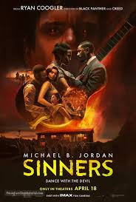
Sinners (2025)

Slide 2
Key People
Directed and Written by Ryan Coogler (Black Panther, Creed)
Starring:
  Michael B. Jordan (Black Panther, Creed)
  Hailee Steinfeld (Across the Spiderverse, Hawkeye)
  Jack O’Connor (28 Years Later, Private Peaceful)
  Wunmi Mosaku (Deadpool and Wolverine, Lovecraft Country)
  Miles Caton (Debut role)
  Jayme Lawson (The Batman (2022), The Woman King)
Music by Ludwig Göransson (Black Panther, Creed, Venom)
Costume by Ruth E. Carter (Black Panther, Wakanda Forever – Oscar winner for each of these)

Slide 3
Key Info
Theatrical Release: 16th April 2025 (18/04/2025 UK)
15 Age Rating
Production Companies: Warner Bros, Domain Entertainment, Proximity Media
Budget: $90,000,000
Box Office: Opening weekend US & Canada $48,007,468, Gross worldwide $366,678,513
Nominations: 6 Astra Awards, 2 Critics’ Choice Awards, 4 Golden Trailer Awards. Nominated for 19 other awards to date.
In exchange for the distribution rights to the film, Coogler was asking studios for first-dollar gross, final cut privilege, and ownership of the film twenty-five years after its release.

Slide 4
Narrative - Propp
In Propp’s Narrative Theory, characters are sorted into narrative archetypes that they fulfil.
These are:
  Prize – what both the Hero and the Villain are striving for. Also known as the Princess. Can also be an object or place.
  Hero – the protagonist, attempts to repair the problems in the story. Typically wins the prize.
  Villain – attempts to stop the hero in their quest. Is ultimately defeated. Does not win the Prize.
  Helper – a sidekick of sorts. Helps the Hero on their quest. Often helps to save the Hero from a perilous situation.
  Donor – provides the Hero with something essential to help them achieve their goal.
  Dispatcher – sets the Hero on their quest. Typically recognises the disruption before anyone else.
  False Hero – may appear as being a good guy but disrupts the Hero’s progress.

Slide 5
Narrative - Propp
For Sinners, sort the following characters into the correct role:
Hero
Villain
Prize
Dispatcher
Donor
Helper
False Hero
Sammie
Smoke
Stack
Mary
Annie
Delta Slim
Pearline
Grace
Remmick
The Klan

Slide 6
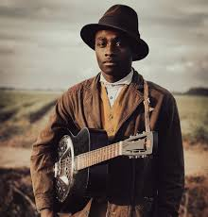
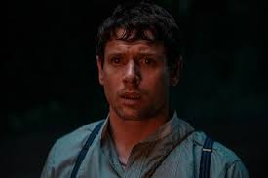
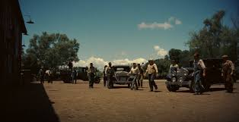
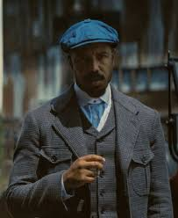
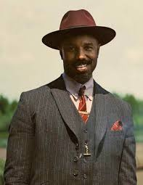
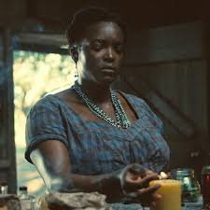
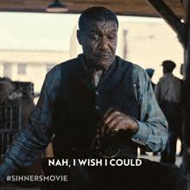
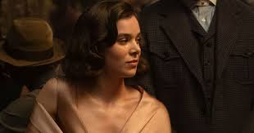
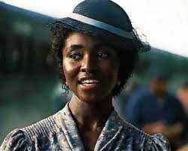
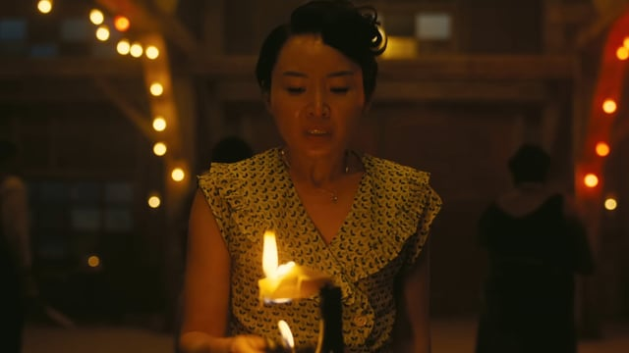
Narrative - Propp
Prize
Villain
Villain
Sammie = prize
Remmick/Klan = villain
Smoke = hero
Annie = dispatcher
Stack/Mary = false hero
Slim = helper
Pearline/ Grace = donor
False Hero
Dispatcher
Hero
False Hero
Helper
Donor
Donor

Slide 7
Narrative - Todorov
Equilibrium – the “normal” of the world of the film
Disruption – inciting incident which causes the Equilibrium to be disrupted
Recognition – when the disruption is recognised by the characters
Attempt to Repair – the characters try to solve the problem
New Equilibrium – “normality” is restored but this may be different from the beginning

Slide 8
Narrative - Todorov
Work out the main events in the film which signal each narrative stage:
Equilibrium
Disruption
Recognition
Attempt to Repair
New Equilibrium

Slide 9
Narrative- Todorov
Equilibrium - Sammie in the fields, before Smoke & Stack turn up
Disruption - prepping for Juke Joint with Smoke & Stack, arrival of Remmick
Recognition of Disruption - Remmick and Company arrive at Juke, start turning others
Attempt to Repair - Fight with Vampires
New Equilibrium - Sammie leaving home

Slide 10
Narrative – Eastern Four Act Structure
Kishōtenketsu as a narrative structure does not centre conflict as part of its structure, especially when compared to common Western narrative structures like Joseph Campbell's "Hero's Journey." This has led to the structure being popularly described as "without conflict,“ although narratives created using kishōtenketsu, such as the 2019 South Korean film Parasite, can and often do contain conflict. (wikipedia)
Introduction: an introduction to the characters, era, and other information required to understand the plot.
Development: follows leads towards the twist in the story. No major changes so far.
Twist: the story turns toward an unexpected development. This is the climax of the story. If the narrative takes several turns, this is the biggest one.
Conclusion: also called ending, wraps up the story

Slide 11
Narrative – Eastern Four Act Structure
Identify the events in the film which match the four acts:
Introduction:
Development:
Twist:
Conclusion:

Slide 12
Narrative – Eastern Four Act Structure
Introduction: Start of film, intro to Sammie, sharecroppers, etc
Development: Setting up the Juke
Twist: Mary turns Stack
Conclusion: End of film, Vampires defeated, Sammie leaves

Slide 13
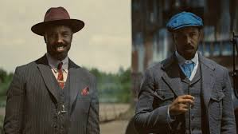
Narrative – Binary Oppositions
Smoke and Stack (serious vs laid back, human vs vampire)
Black and White (sharecroppers, juke vs Klan, Remmick)
Human and Vampire (Juke vs Remmick & Co.)
Church and Juke (use of music, control vs freedom)

Slide 14
Genre
Horror (horror noir) – vampires, tone shift, use of music, use of lighting
Historical Period Piece – set in Mississippi Delta 1932, costume, references to Al Capone (Italian and Irish mob in Chicago), Sharecropping community (Jim Crow laws, KKK), post WW1 – references to fighting in the war
Musical – music is integral and active part of the plot, not fully integrated into film – film about music rather than true musical

Slide 15
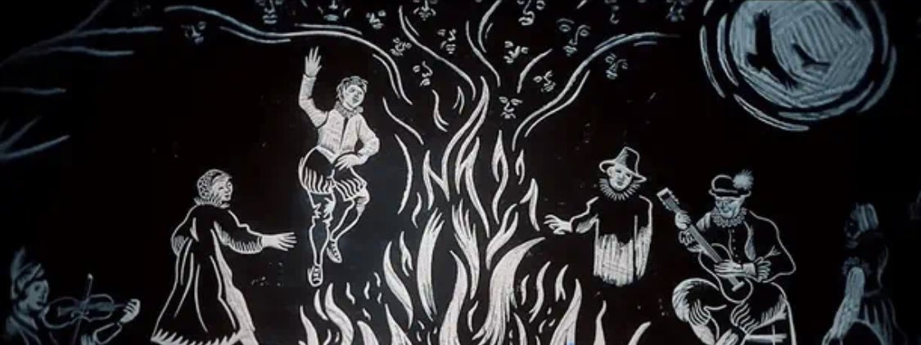
Language – Opening sequence
Camera
Sound
Mise-en-Scene
Colour
Lighting
Editing

Slide 16
Opening Sequence Notes
Smoke and Stack outside the Mill – Stack “outside” while Smoke is “inside”
Extreme Long shots of fields, Sammie arriving at Church – setting the scene, idea of time & place
Camera follows Sammie as he moves away from the pulpit to leave the church – foreshadows his leaving the plantation
First shot of church very desaturated vs later shot which is very bright, saturated – desaturated after he has lost his faith (at night in the Juke)
Natural light –sunlight vs inside the church is very dark – lack of freedom due to father’s demands/expectations vs freedom outside
Woodcut sequence at the start black and white with red eyes – traditional feel, storybook, ominous – lends to horror genre especially red eyes
Mostly soft strumming guitar but changes when we see the guitar and his father mentions dancing the with devil – more ominous, sense of danger
Cars establish time period, Smoke and Stack costume very formal Smoke dressed like the Irish mafia, Stack like the Italian mafia – tells us how they ran with both sides (and stole from them), foreshadows them being on different sides
Sammie working in the fields (still singing) – implies he will have the musical talent mentioned in the woodcut sequence, idea of time and place
Sammie and his father – some conflict as Sammie wants freedom but also wants to respect his father

Slide 17
Opening Sequence Notes
Mississippi Delta accent, “Keep dancing with the Devil one day he’s gonna follow you home” – foreshadowing later events, references tag line on poster
Guitar – pacing changes occasionally but mainly slow strumming guitar, Blues – peaceful, very little conflict, slight changes indicate a change in conflict level
Editing – fast jump cuts of Remmick at the start – flashbacks – trauma response, lots of shorter shots, lots of back and forth between Sammie and the Twins – establishing them as main characters
Cut from watching them drive away to inside the car – going on a journey

Slide 18
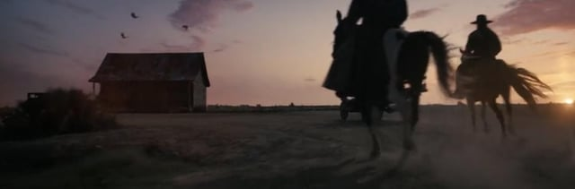
Language – Arrival of Remmick
Camera
Sound
Mise-en-Scene
Colour
Lighting
Editing

Slide 19
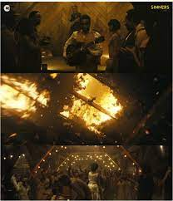
Language – Dancing with the Ancestors
Camera
Sound
Mise-en-Scene
Colour
Lighting
Editing

Slide 20
Dancing with the Ancestors Notes
Low angle shot of roof burning
Music changes when camera tilts to Remmick becomes more intense, ominous
Costume – ancestors and future
Props – different instruments
Camera moves around Juke
Showing various spirits of past & future
Shift in aspect ratio – move to full screen when ancestors start to appear – supernatural
Editing – cut to Delta Slim but few others, cut to Remmick at end
Colour – warm colours, colourful costume, sepia toned
Lighting – fire, lighting inside Juke, Night = dark
Sammie summons ancestors
Grace asking Bo to dance
Delta Slim – “music brings together the past and future” – serious, Mississippi delta
Blues music, hip hop, rock, traditional African drums, Chinese opera music

Slide 21
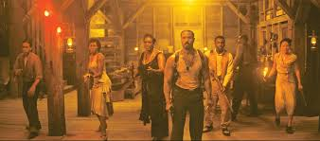
Language – Fight with Vampires
Camera
Sound
Mise-en-Scene
Colour
Lighting
Editing

Slide 22
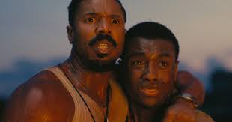
Language – Closing Sequence
Camera
Sound
Mise-en-Scene
Colour
Lighting
Editing

Slide 23
Closing Sequence Notes
Changing aspect ratio – Shorter aspect ratio before arrival of the Klan – comparing them to the vampires – suggests dangerous/evil
Mid-shot of Smoke and Sammie holding onto each other as vampires die – Smoke protecting Sammie from the vampires, Smoke redeeming himself after being unable to protect others
Tracking as grenade thrown into truck – showing the Klan trying (and failing) to escape, shows how dangerous Smoke – one man army
Brighter saturation with Annie and Baby vs the Klan – movement from land of the living to the land of the dead (heaven)
Inside the church = very dark, outside =very bright – Sammie has lost his faith, church as controlling force – is it good?
Text at the end to show change in time/place – old Sammie – free musician
Slowed down ‘Rocky Road to Dublin’ as Remmick dies – change from intense horror music – melancholic – sad, sympathetic for Remmick, its over
Remmick’s claws – deadly, animalistic, loss of humanity, more of a threat
Remmick’s “baptism” of Sammie – mockery of the church, meant to question the church – is it truly good?

Slide 24
Annie and Smoke – she comes to guide him to the afterlife, loving relationship
“I don’t want you getting any of that Smoke on her” – literal cigarette smoke but also that she doesn’t want any of Smoke’s darker side near the baby
Intense, electric guitar rather than acoustic blues – more horror than historical at this point, intense, scary
Lots of jump cuts between different action - lots of things happing at once, more intense
Fade out when Sammie arrives outside the church – transition between church and Juke – suggestion that Sammie no longer belongs – will leave
Jump to credits – jump in time, Sammie’s ability to join spirits of past and future – editing joins past to future

Slide 25
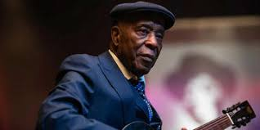
Language – Post Credit Scenes
Camera
Sound
Mise-en-Scene
Colour
Lighting
Editing

Slide 26
Whole stage set up – Sammie’s made it big
Low angle shots looking up at Sammie – made it big, he survived, he’s won
No significant camera movement
Dark and warm – similar to Juke, a little brighter – entrance turns red when Stack enters – danger, Stack’s colour
Artificial lighting – stage lighting, bar - dark, Sammie only one lit up – made it big
Title card – Sinners – white writing on black background, old, from the past
Sammie’s electric guitar vs acoustic – past vs “future”
Costumes show change of time period – Sammie’s costume contains parts of both Smoke and Stack’s prev costumes – keeps parts of them with him
Sammie playing on stage vs playing for Stack – performance vs nostalgia
Stack and Sammie – Stack offers to turn Sammie, hug at the end = closeness between them
“last time I saw my brother” – Stack has literally never seen his brother’s face again due to having no reflection, sad, nostalgic, shows love between the twins
Haunting music when Stack and Mary enter – danger approaching, ghosts from the past
Smooth cuts/fades – almost in time with music, no disruption

